Slide 1
JAVA ARCHITECTURE
BY
PADMA PRIYA

Slide 2
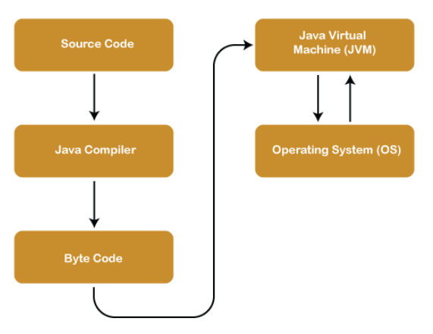
JAVA ARCHITECTURE

Slide 3

Components of
Java Architecture
Java Virtual Machine (JVM)
Java Runtime Environment (JRE)
Java Development Kit (JDK)

Slide 4
JVM
JVM acts as a runtime engine .
JVM is the one that actually calls main method in the code.
JVM loads the code into the memory and then verifies it.
Then executes the code and provides it to runtime environment.
JAVA VIRTUAL MACHINE

Slide 5
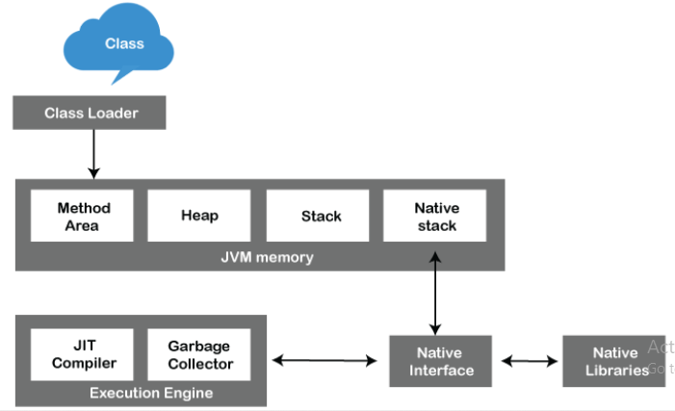
JVM ARCHITECTURE

Slide 6
JRE
JRE is a part of JDK.
The JRE loads classes, verify access to memory, and retrieves the system resources.
JRE acts as a layer on the top of Operating System.
JAVA RUNTIME ENVIRONMENT

Slide 7
Components of JRE
User interface toolkits
Integration libraries
Other base libraries
Lang and util base libraries
Java Virtual Machine (JVM)

Slide 8
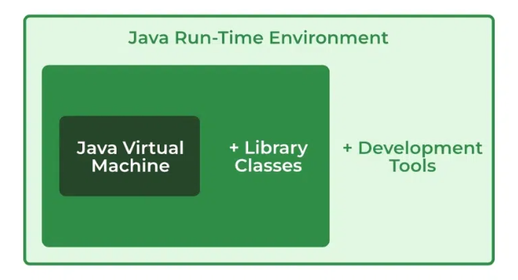
JRE

Slide 9
JDK
The Java Development Kit (JDK) is a cross-platformed software development environment .
It is used to develop java applications and applets.
It physically exists.
It contains JRE + development tools.
JAVA DEVELOPMENT KIT

Slide 10
Components of JDK
JVM
Interpreter/loader(java)
Compiler(javac)
An archiver(jar)
A documentation generator(Javadoc)
appletviewer.

